Slide 1
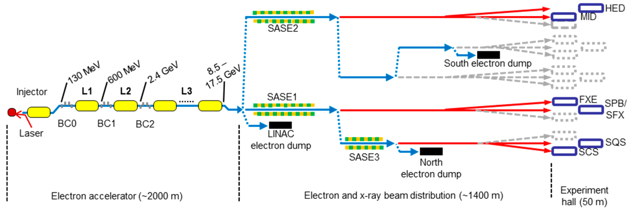
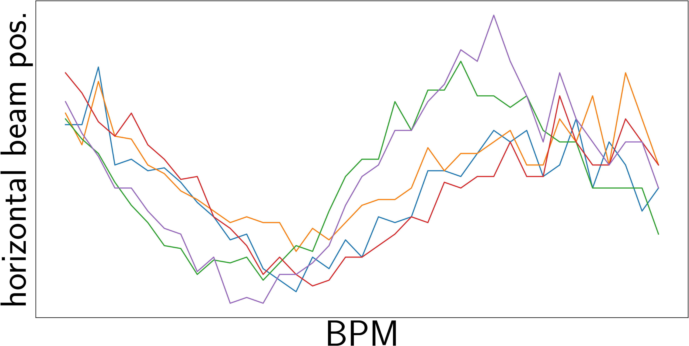
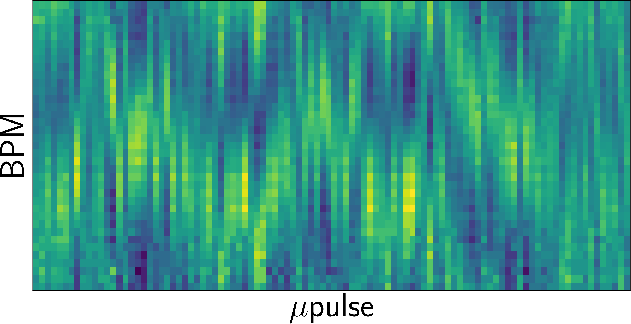

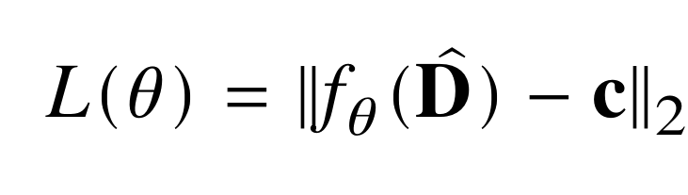

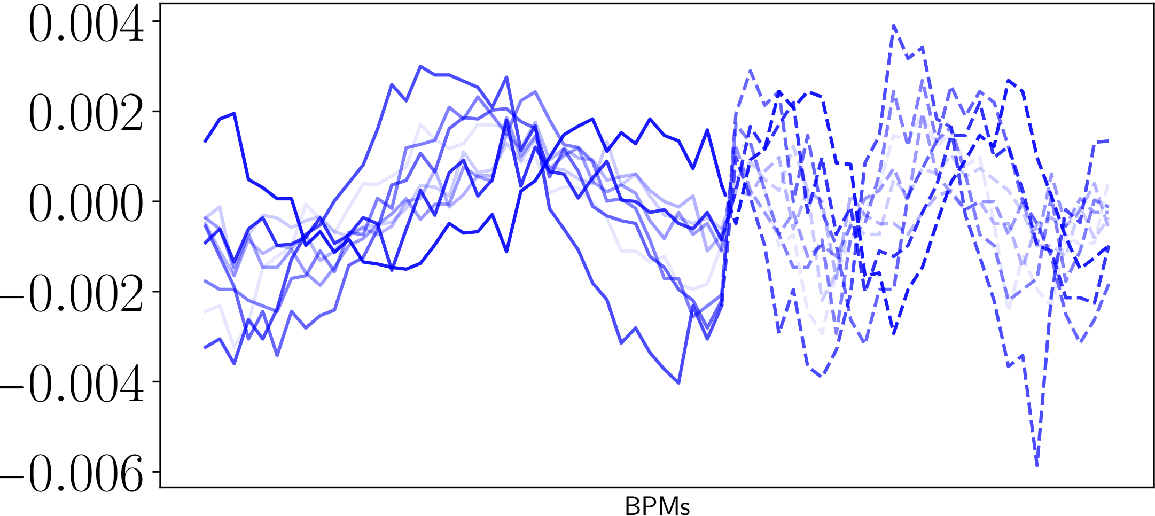
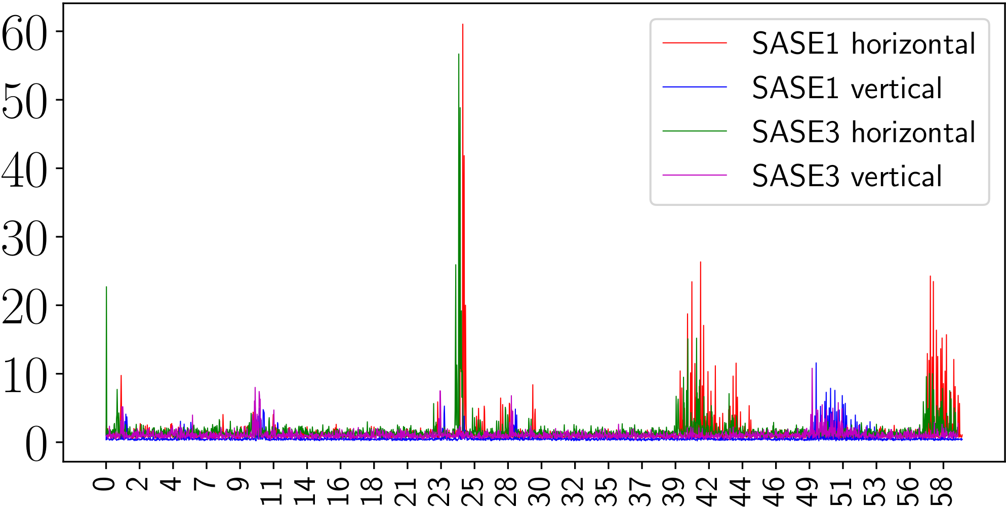
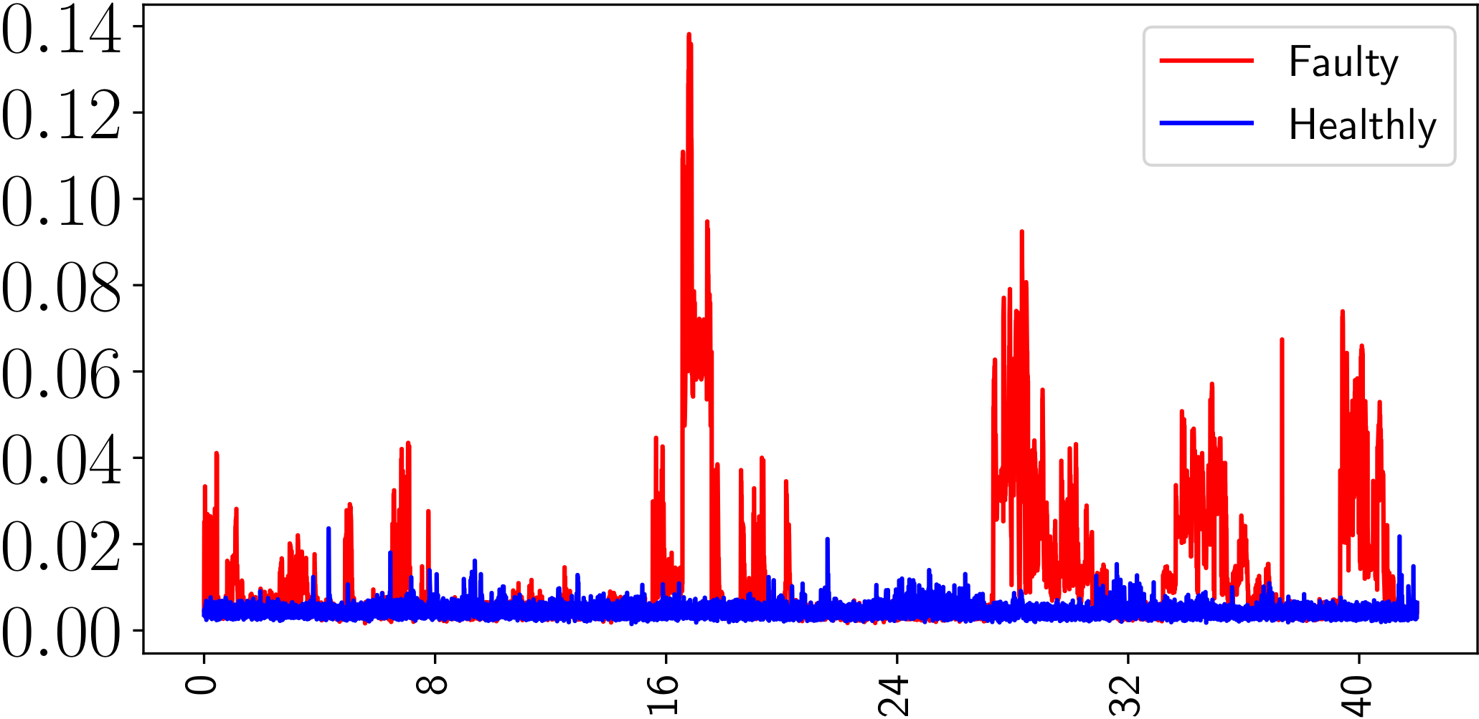
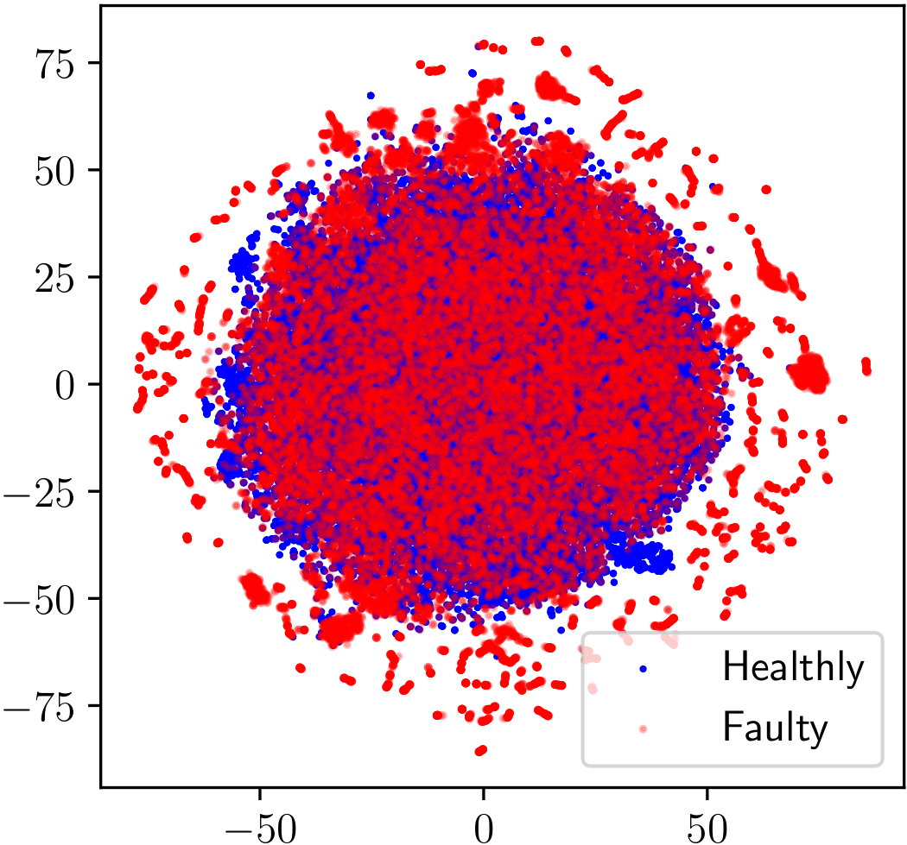
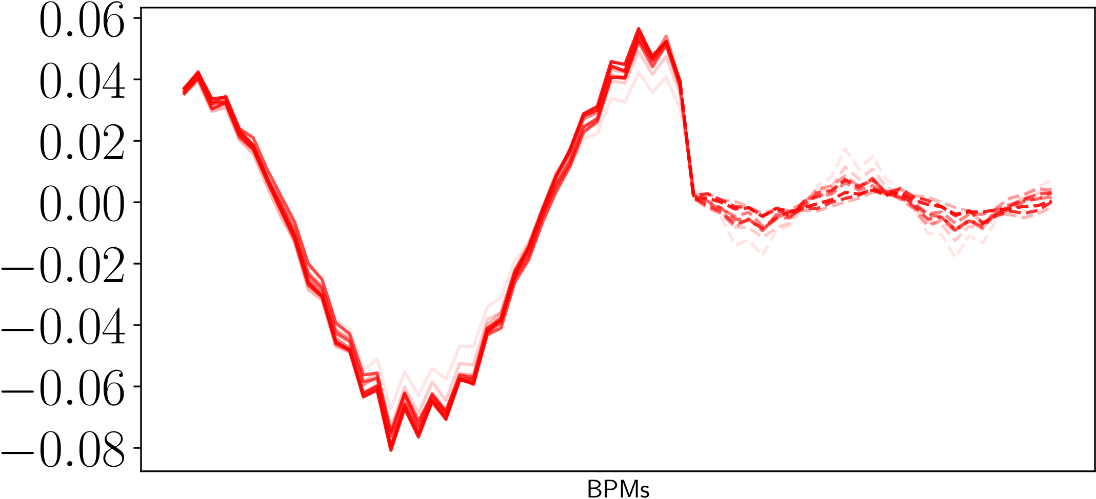
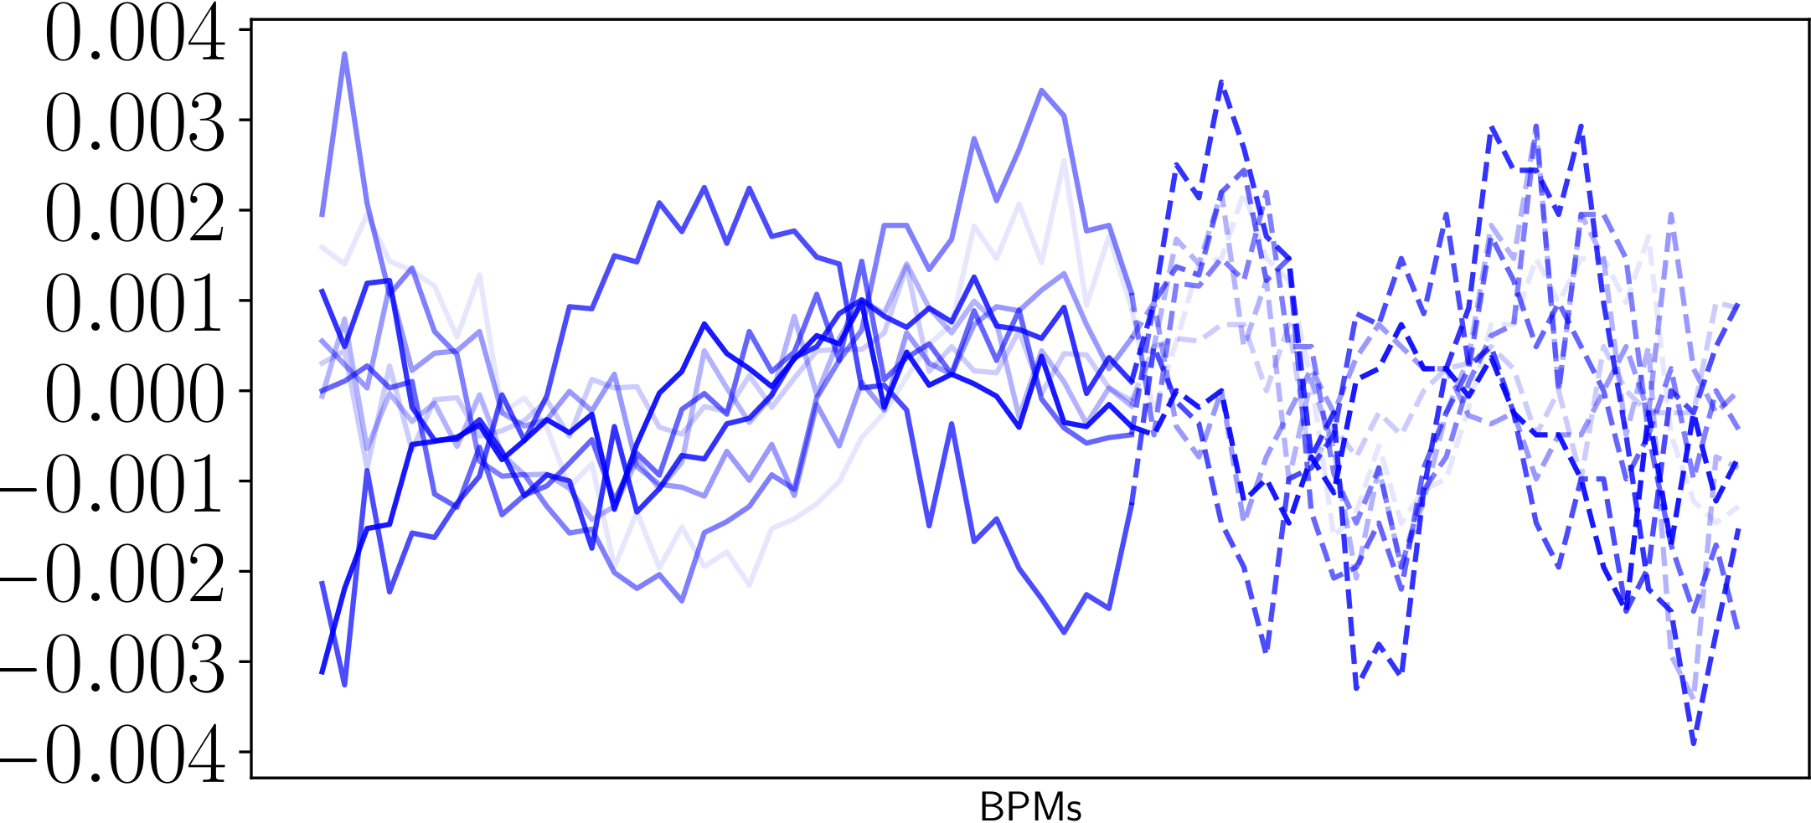
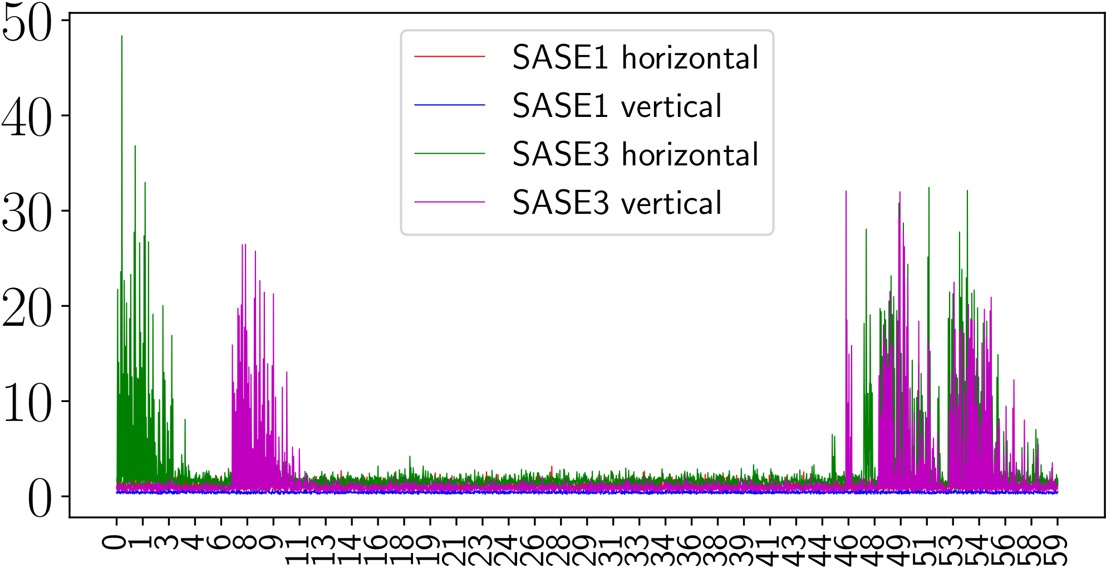
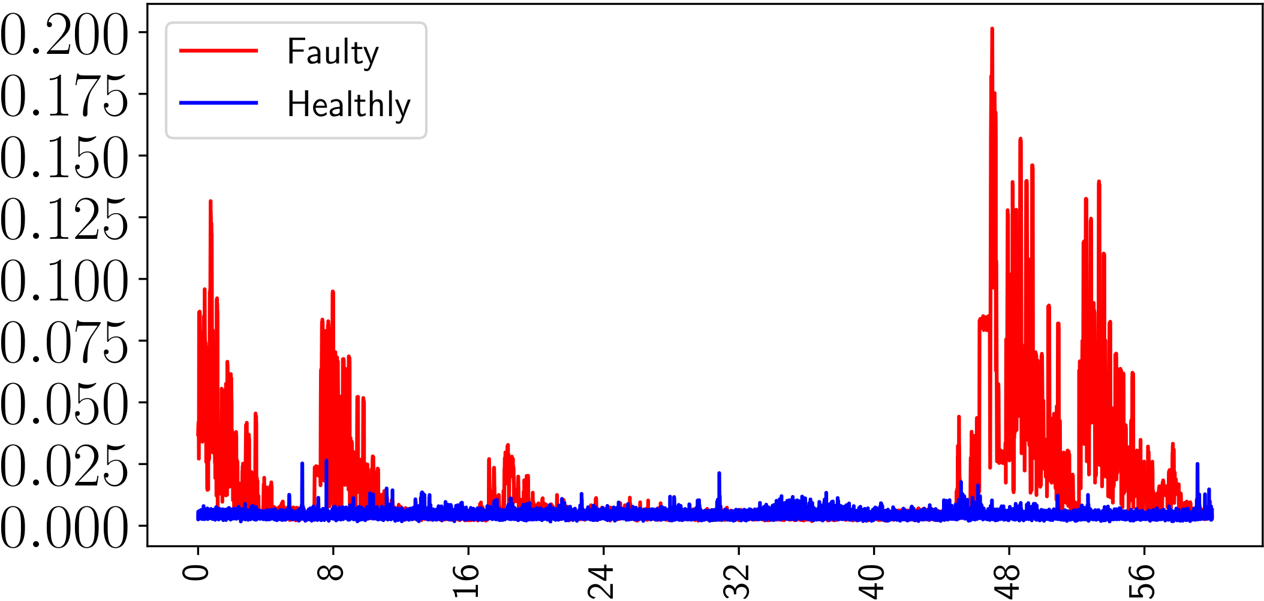
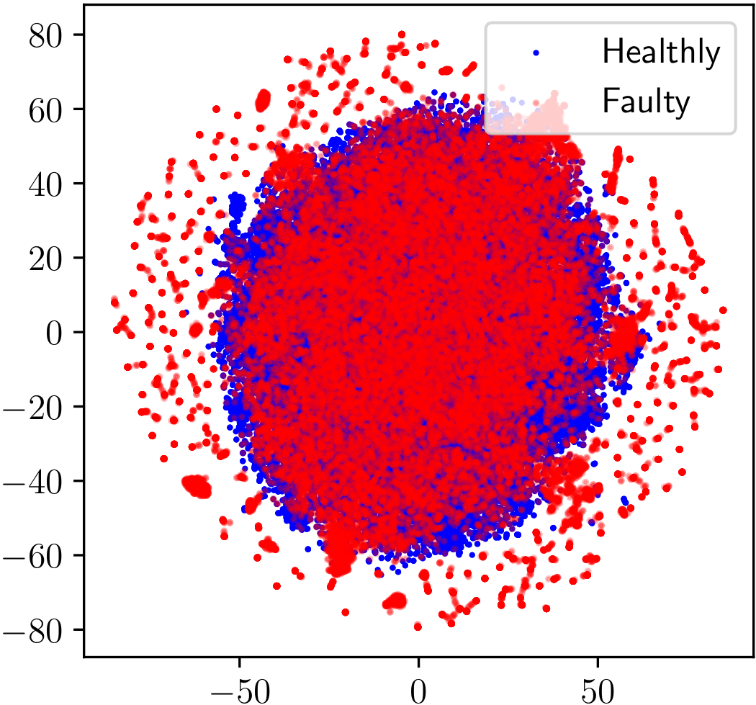
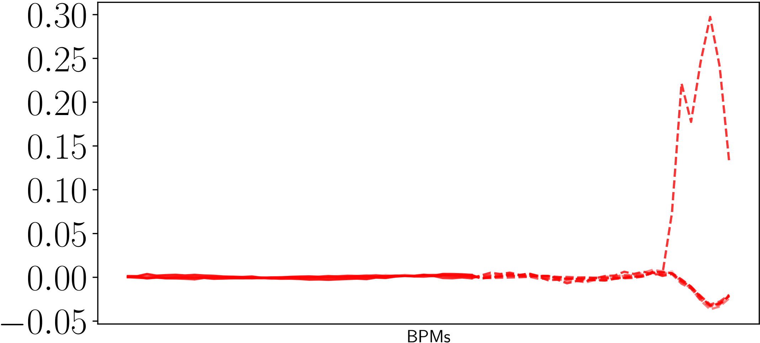



A Data-Driven Beam Trajectory Monitoring at the European XFEL
Antonin Sulc, Raimund Kammering, Tim Wilksen
DESY, Hamburg
Abstract
Interpretation of data from beam position monitors is a crucial part of the reliable operation of European XFEL. The interpretation of beam positions is often handled by a physical model, which can be prone to modeling errors or can lead to the high complexity of the computational model.
We show two data-driven approaches that provide insights into the operation of the SASE beamlines at European XFEL. We handle the analysis as a data-driven problem, separate it from physical peculiarities and experiment with available data based only on our empirical evidence and the data.
Inputs
Method
The beam optics in the undulator lines are controlled by the use of a so-called FODO lattice.
These alternating magnetic fields can introduce a periodic variation of the trajectory named betatron oscillation [1].
We can observe a specific periodic pattern of the electron bunches passing through the FODO lattice.
Data-Driven Method
Assumption: The anomalies are spread over multiple bunch trains.
Working with sequences is particularly important in taking into consideration anomalies that are spread over multiple bunch trains.
An attention layer [2] can access all previous states in sequences and weight them according to the learned relevance.
The network architecture consists of a two-layer transformer with a linear layer in the output.
Since we do not have explicit labels we adopted the One-Class-Loss [3] to train the model
Empirical Method
Assumption: Beta-function must follow a period that reminds a period pattern which reminds sine function.
We define g as a sine function parameterized with amplitude, period, phase shift and frequency.
Individual beam pos. should mirror their fitted functions g.
The model f and hypersphere center c are gradually trained to transform inputs D̂ to a lower-dimensional feature space where the common inputs are transformed to be close to c.
Results
Crash of the undulator server after an unusual selection of colors for individual cells.
Healthy / Faulty SASE1 and SASE3 Trajectories
Horiz. and vert. r of the empirical method
Anomaly scores s of data-driven model
TSNE Embedding of f
Conclusion
Two approaches for the analysis of beam dynamics at EuXFEL:
Empirical approach based on our evidence about the beta-function which provides a direct interpretable indication of the beam position data by fitting a sine function.
A purely data-driven approach that allows more complex inputs of the inter-bunching relations.
The presented approach reveals that we are already able to identify some issues taking place where beam trajectories.
Experiments show that both approaches are similarly efficient with revealing problems on beam trajectory.
There is a limited ability to correlate an issue with its effects on the position of the beam.
References
[1] B. Holzer, “Beam dynamics in synchrotrons,” arXiv preprint arXiv:1804.08873, 2018
[2] A. Vaswani et al., “Attention is all you need,” Advances in neural information processing systems, vol. 30, 2017
[3] L. Ruff et al., “Deep one-class classification,” in International conference on machine learning, PMLR, 2018, pp. 4393–4402.
Phase shifter at SASE3 which does not move.

